Slide 1


Use Power Platform and Microsoft 365 to establish learning process in your organization by Dawid Ziółkowski
collabdays | lisbon
November 13th, 2021

Slide 2

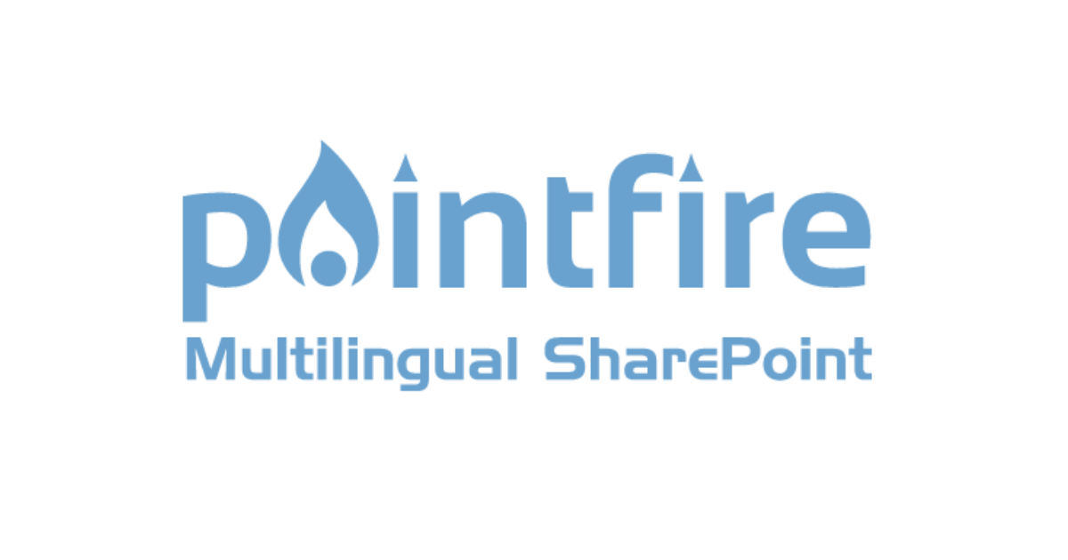





Our Sponsors
GOLD
COMMUNITY

Slide 3









About me
Working in the IT almost 12 years
Started in Support
7 years of SharePoint
6 years of Office/MS 365
2.5 years in Power Platform
Fan of Business process automations and digitalization
Breaker (Break Dancer / Bboy)
@365CornerDavid
/in/dawid-ziolkowski
365corner.pl/

Slide 4
Agenda
How it started
Planning Development
Results of the work
Conclustions

Slide 5
How it started

Slide 6
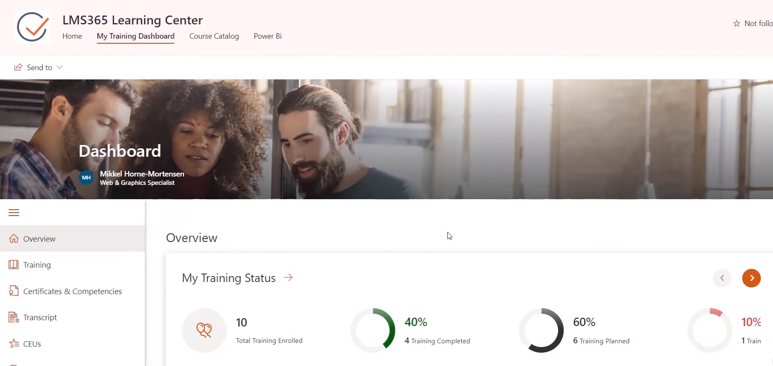
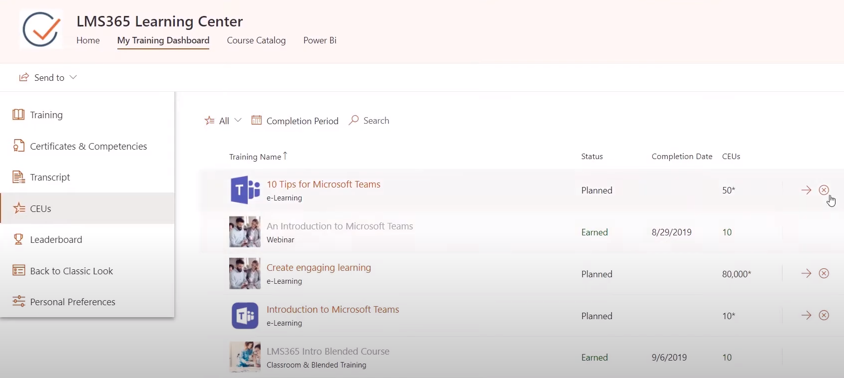
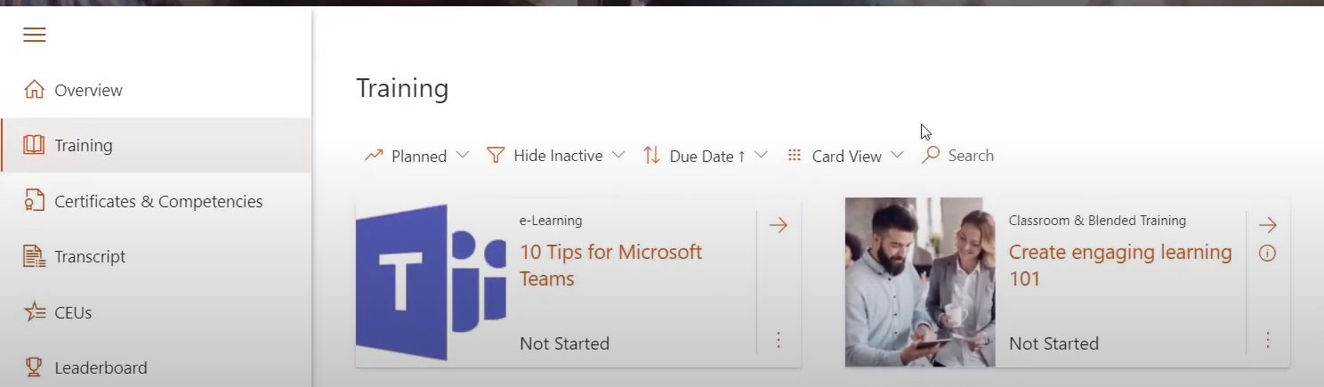
Why
Business Request to investigate LMS365

Slide 7
BUT
But LMS365 related to the huge LICENCES fee cost…
We asked the question:
Can we do it in different way?

Slide 8
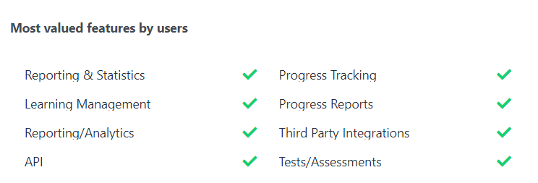
Key features
What are the key features to be covered?
LMS365:

Slide 9
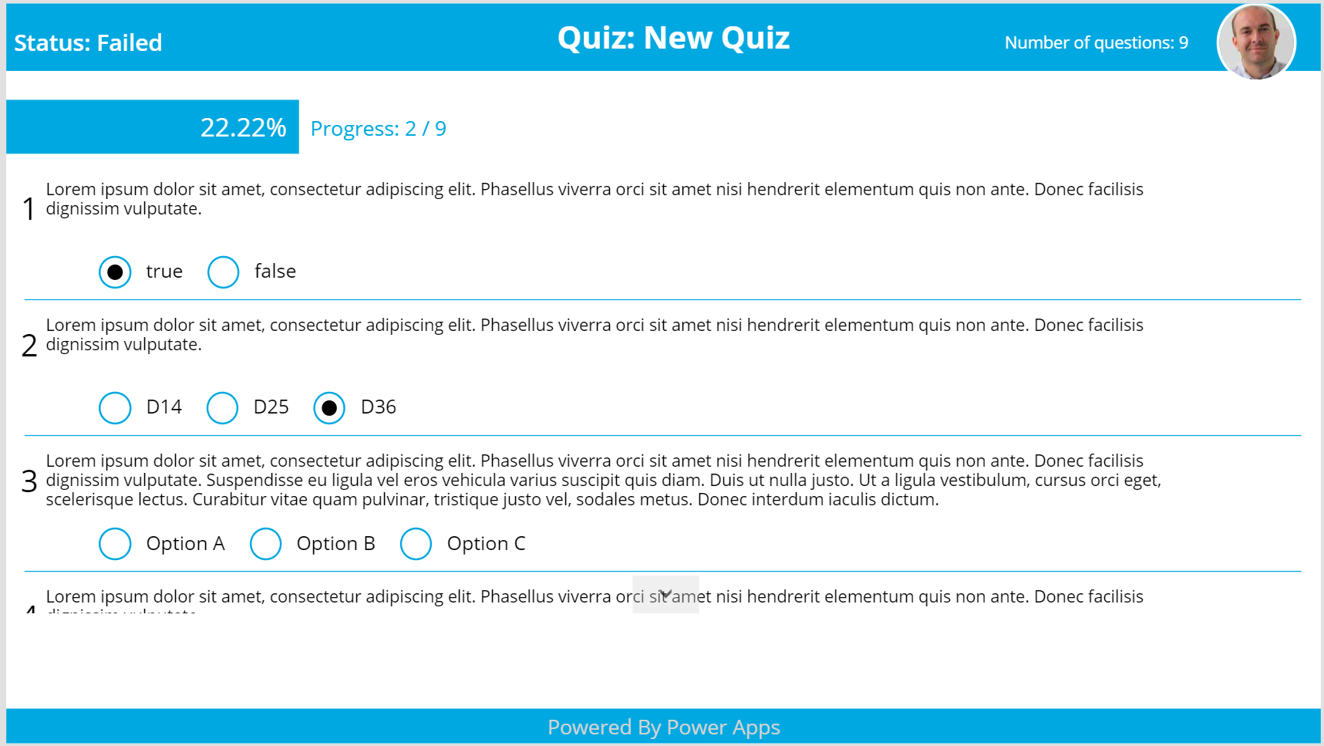
POC
With Power Apps in 2 days the POC of Quiz solution has been created. (including Quiz management).

Slide 10
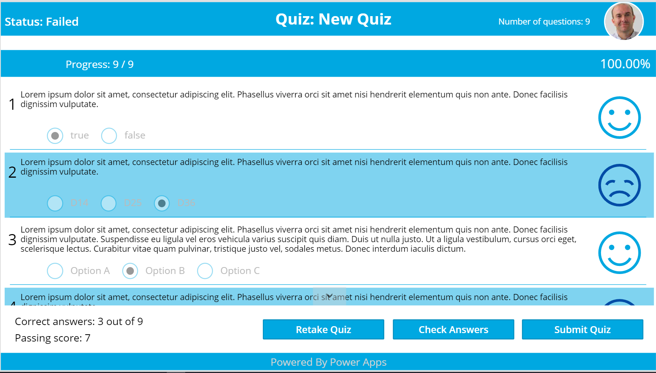
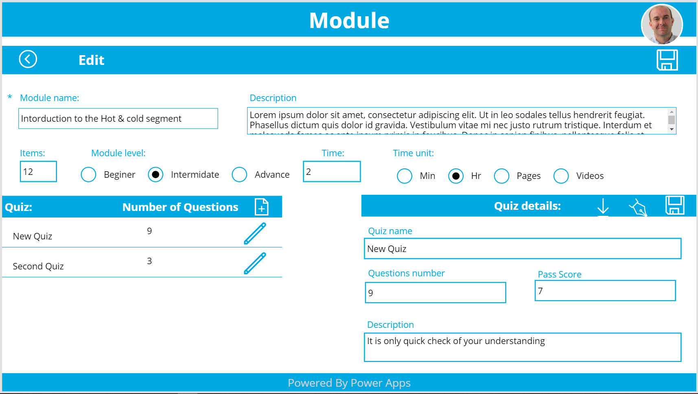
POC

Slide 11

Result of POC
Business was happy and we get green light!
Benefits:
Only development time is a cost
Solution made for company
Easy way to say stop
Materials build in the fast for migration way

Slide 12
Demo
Quiz module
Notes:
Vesa

Slide 13
Planning Development

Slide 14
Planning Development
Work done in Agile way
2 weeks sprints
Business was involved from the start to end.
Weekly catch ups !
Ability to add the comments and apply corrections.

Slide 15
Planning Development
Stage 1
Quiz and management
Recommendations
Content Creators board
Tracking

Slide 16
Planning Development
Stage 2
Manage Team
Reporting
Modules Display

Slide 17
Solution Stage 1 & Stage 2
Demo
Notes:
Vesa

Slide 18
Results of the work

Slide 19
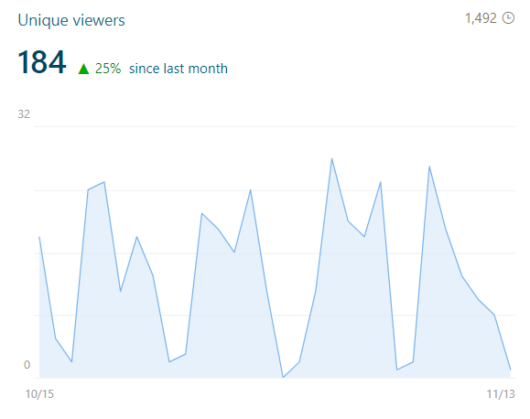
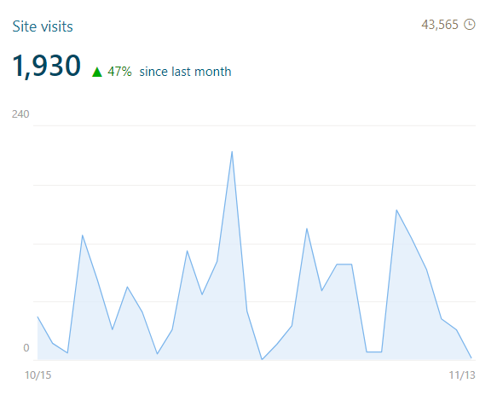
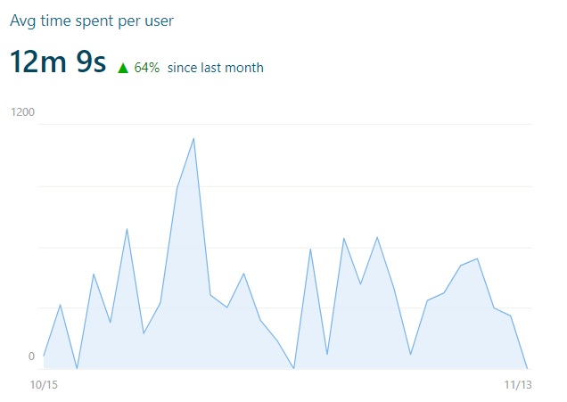
Result of the work

Slide 20
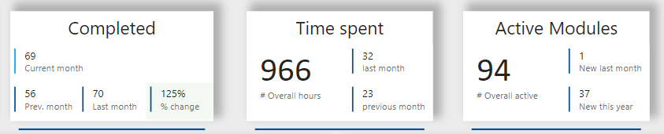
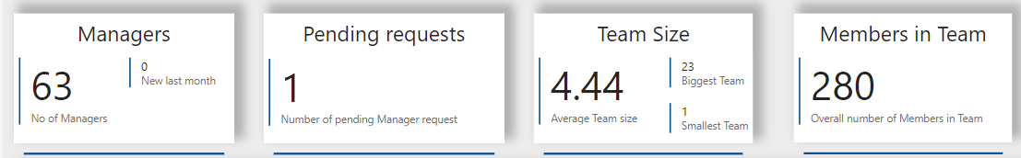
Result of the work

Slide 21
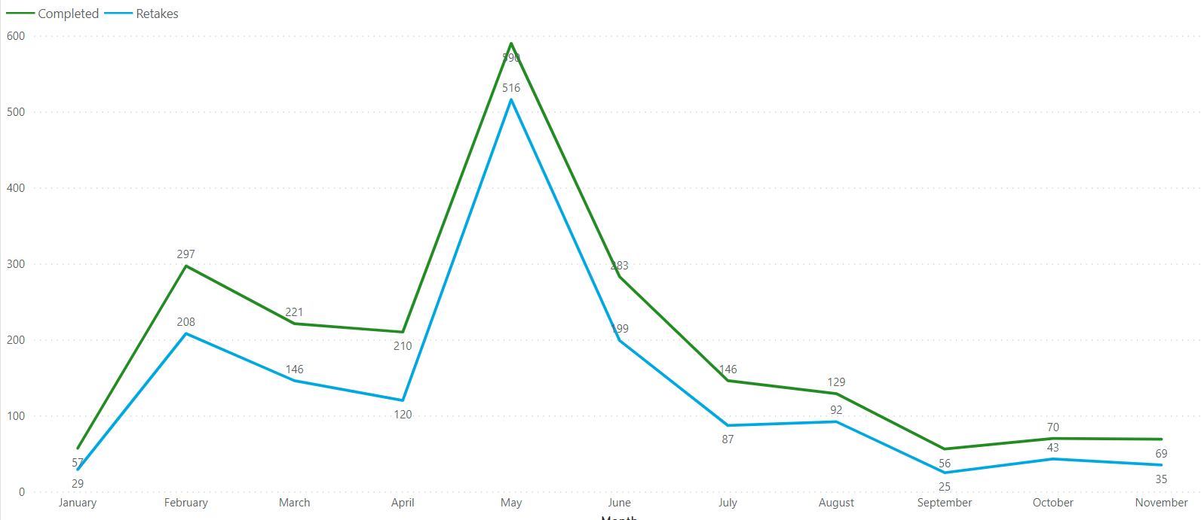
Result of the work
This is some text point
Other Text point

Slide 22
Summary

Slide 23
What Next?
Further possibilities of Development:
Connection with Power Virtual Agent
Connection with other systems (matter of connector)
Connection with Viva Learnings!
User data per region
Modules cross Pathways

Slide 24
Power Virtual Agent integration
Demo
Notes:
Vesa

Slide 25
Conclusion
Thanks to Power Platform we manage to deliver useful solution which is:
Free no additional cost (Only development time)
Solution made for company
Easy way to say stop
Materials build in the fast for migration way

Slide 26
Thank you
Thank you for your attention, let’s stay connected.
@365CornerDavid
/in/dawid-ziolkowski
365corner.pl/

Slide 27
Our Sponsors
GOLD
COMMUNITY

Slide 28


